Slide 1

Unit-5 Mathematics
Indian Knowledge System
#2301DU005
Prof. Deepraj K. Patadia
Civil Engineering Department
deepraj.patadia@darshan.ac.in
7990475865

Slide 2

Looping
Mathematics
Unique aspects of Indian Mathematics
Mathematicians and their contribution
Square of a Number & Square Root
Series and Progression
Overview and Important of Geometry
Trigonometry and Algebra

Slide 3
Unique aspects of Indian Mathematics

Slide 4
Indian Mathematics
Indian mathematics has a rich and diverse history, contributing significantly to global mathematical knowledge. Here are some unique aspects.
Invention of Zero: The concept of zero (śūnya) as both a placeholder and a number in its own right was first used in Indian mathematics. It revolutionized number systems and calculations worldwide.
Decimal Number System: India developed the base-10 decimal system, including the positional notation of numbers, which is now used universally.

Slide 5
Indian Mathematics
Early Algebra: Indian mathematicians like Aryabhata and Bhaskara made early advancements in algebra. They developed rules for solving quadratic equations, sums of series, and worked on the concept of negative numbers.
Contributions to Trigonometry: Indian scholars like Aryabhata and Bhaskara II made significant contributions to trigonometry, including defining sine (jya) and cosine (kojya), which later influenced the development of trigonometry in Islamic and European mathematics.

Slide 6
Indian Mathematics
Aryabhata’s Approximation of Pi: Aryabhata calculated the value of π (Pi) to four decimal places (3.1416), which was remarkably accurate for the time and influential in mathematical developments worldwide.
Baudhāyana’s Theorem: Baudhāyana, an ancient Indian mathematician, discovered a theorem that predates the Pythagorean theorem, describing the relationship between the sides of a right-angled triangle.

Slide 7
Indian Mathematics
Bhaskara II’s Work on Calculus: Bhaskara II in the 12th century introduced early concepts related to differential calculus, including the derivative and the notion of infinitesimals, long before Newton and Leibniz.
Kātyāyana Sulba Sutras: The Sulba Sutras, ancient Indian texts, contain rules for geometric constructions, including precise measurements for constructing altars, and solutions for geometric problems.

Slide 8
Indian Mathematics
Chakravala Method: This cyclic method for solving quadratic indeterminate equations (also known as Pell’s equation) was developed by Indian mathematicians and admired for its efficiency by later European mathematicians.
Vedic Mathematics: A set of mental calculation techniques that originated in ancient India, used for quick problem-solving and enhancing computational skills.

Slide 9
Indian Mathematics
Aspect | Description
Invention of Zero | Introduced zero as both a placeholder and a number in its own right.
Decimal Number System | Developed the base-10 system with positional notation.
Early Algebra | Contributions to solving quadratic equations and using negative numbers (Aryabhata, Bhaskara).
Trigonometry | Defined sine (jya) and cosine (kojya), key advancements by Aryabhata and Bhaskara II.
Approximation of Pi (π) | Aryabhata calculated π to four decimal places (3.1416).
Baudhāyana’s Theorem | Precursor to the Pythagorean theorem, relating the sides of a right-angled triangle.

Slide 10
Indian Mathematics
Aspect | Description
Baudhāyana’s Theorem | Precursor to the Pythagorean theorem, relating the sides of a right-angled triangle.
Early Calculus Concepts | Bhaskara II introduced ideas related to derivatives and infinitesimals.
Geometric Constructions | The Sulba Sutras provided rules for precise geometric constructions.
Chakravala Method | Efficient cyclic method for solving quadratic indeterminate equations.
Vedic Mathematics | Mental calculation techniques for quick problem-solving.

Slide 11
Mathematicians & their contribution
Mathematician | Time Period | Major Contributions
Aryabhata | 476–550 CE | - Approximation of π (Pi) to 3.1416 - Contributions to trigonometry (sine, cosine) - Solving quadratic equations
Brahmagupta | 598–668 CE | - Defined zero as a number - Rules for operations with zero and negative numbers - Solutions to quadratic equations
Bhaskara I | 600–680 CE | - Introduced rational approximation of sine - Early work on positional notation
Bhaskara II (Bhaskaracharya) | 1114–1185 CE | - Early concepts of calculus (differentiation, infinitesimals) - Chakravala method for solving quadratic equations - Work on algebra, arithmetic, and astronomy

Slide 12
Mathematicians & their contribution
Mathematician | Time Period | Major Contributions
Baudhāyana | 800 BCE | - Baudhāyana’s theorem (predecessor of the Pythagorean theorem) - Contributions to geometric constructions in the Sulba Sutras
Madhava of Sangamagrama | 1340–1425 CE | - Developed infinite series for sine, cosine, and arctangent - Considered the founder of mathematical analysis
Varāhamihira | 505–587 CE | - Work in trigonometry and algebra - Contributions to Indian astrology and astronomy
Srinivasa Ramanujan | 1887–1920 | - Contributed to number theory, infinite series, continued fractions - Famous for Ramanujan’s summation and partition theory
Narayana Pandita | 1340–1400 CE | - Work in combinatorics, magic squares, and algebra - Contributions to the theory of integer partitions
Kātyāyana | 3rd century BCE | - Contributions to geometric measurements and construction in the Sulba Sutras

Slide 13
Square of a Number & Square Root

Slide 14
Square of a number & Square Root
Square of a Number:
Baudhāyana Sulba Sutras describe early references to squaring numbers and geometric constructions.
Aryabhata introduced methods for calculating squares and solving quadratic equations.
Vedic Mathematics provides mental shortcuts, such as squaring numbers ending in 5.

Slide 15
Square of a number & Square Root
Square Root:
Bhaskara II, in Lilavati, described methods for finding square roots of perfect and imperfect squares.
The Chakravala method was used for solving quadratic equations and finding square roots efficiently.
Aryabhata and others developed algorithms for calculating square roots.
Sulba Sutras used geometric approaches to approximate square roots, especially for religious altar construction.

Slide 16
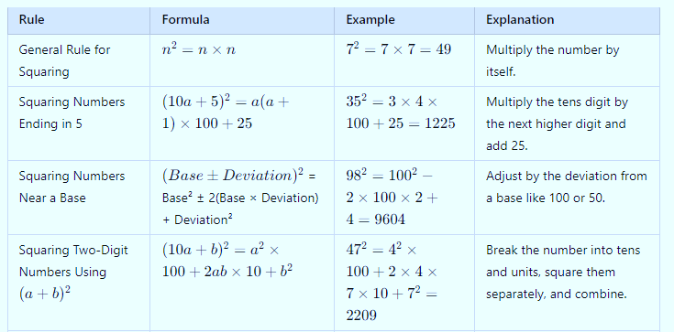
Square of a number & Square Root
Here’s a table summarizing different rules for squaring numbers with examples:

Slide 17
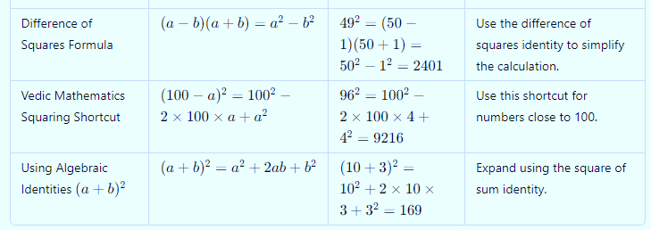
Square of a number & Square Root

Slide 18
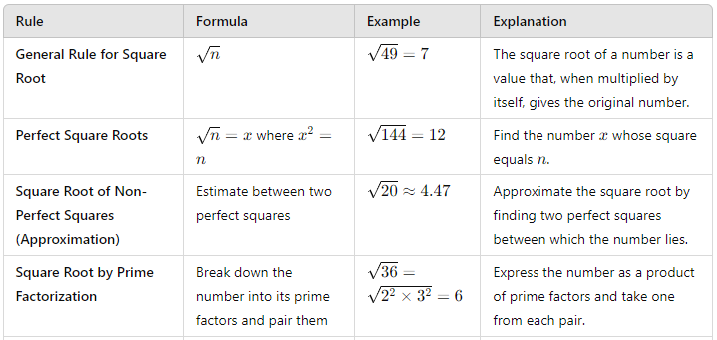
Square of a number & Square Root
Here’s a table summarizing different rules for square root of numbers with examples:

Slide 19
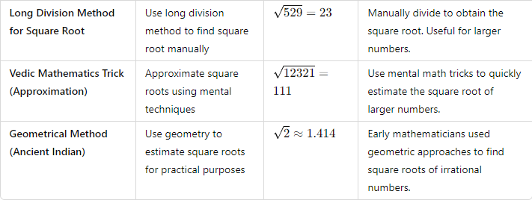
Square of a number & Square Root

Slide 20
Series & Progression

Slide 21
Progression
Progressions and Series are mathematical concepts related to sequences of numbers.
Understanding the basics of progression is essential to move on to series.
Progression
A Progression is an ordered list of numbers that follow a certain rule.
There are various types of progressions, with the most common being Arithmetic Progression (AP), Geometric Progression (GP), and Harmonic Progression (HP).

Slide 22
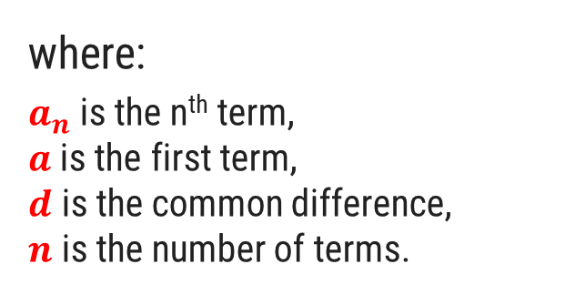
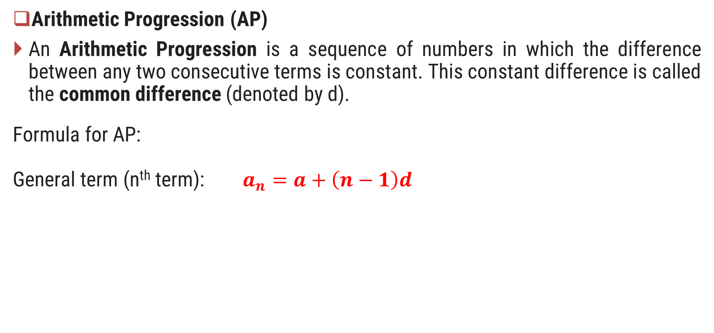
Progression
Arithmetic Progression (AP)
An Arithmetic Progression is a sequence of numbers in which the difference between any two consecutive terms is constant. This constant difference is called the common difference (denoted by d).
Formula for AP:
General term (n^{th} term): $a_{n}=a+\left(n−1\right)d$
where:
$a_{n}$​ is the n^{th} term,
$a$is the first term,
$d$ is the common difference,
$n$ is the number of terms.

Slide 23
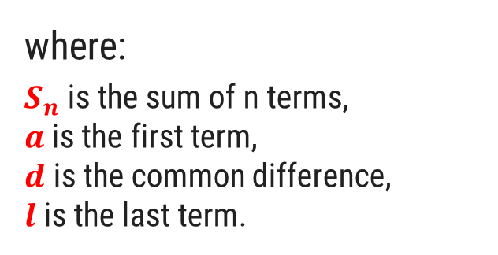
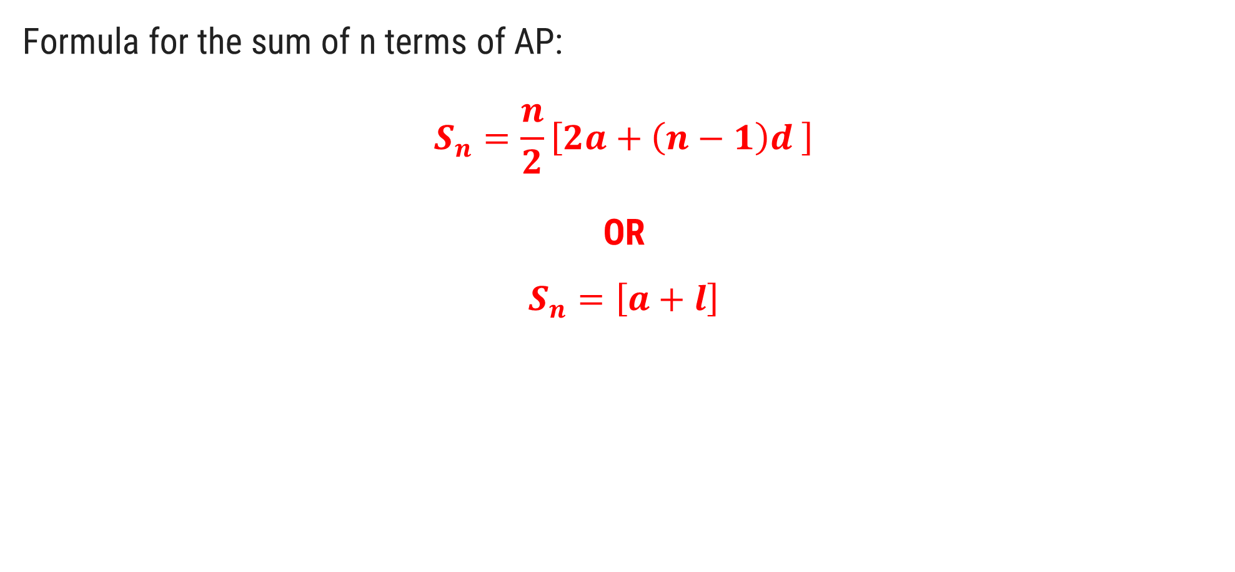
Progression
Formula for the sum of n terms of AP:
$$S_{n}=\frac{n}{2}\left[2a+\left(n−1\right)d \right]$$
OR
$$S_{n}=\left[a+l\right]$$
where:
$S_{n}$​ is the sum of n terms,
$a$is the first term,
$d$ is the common difference,
$l$ is the last term.

Slide 24
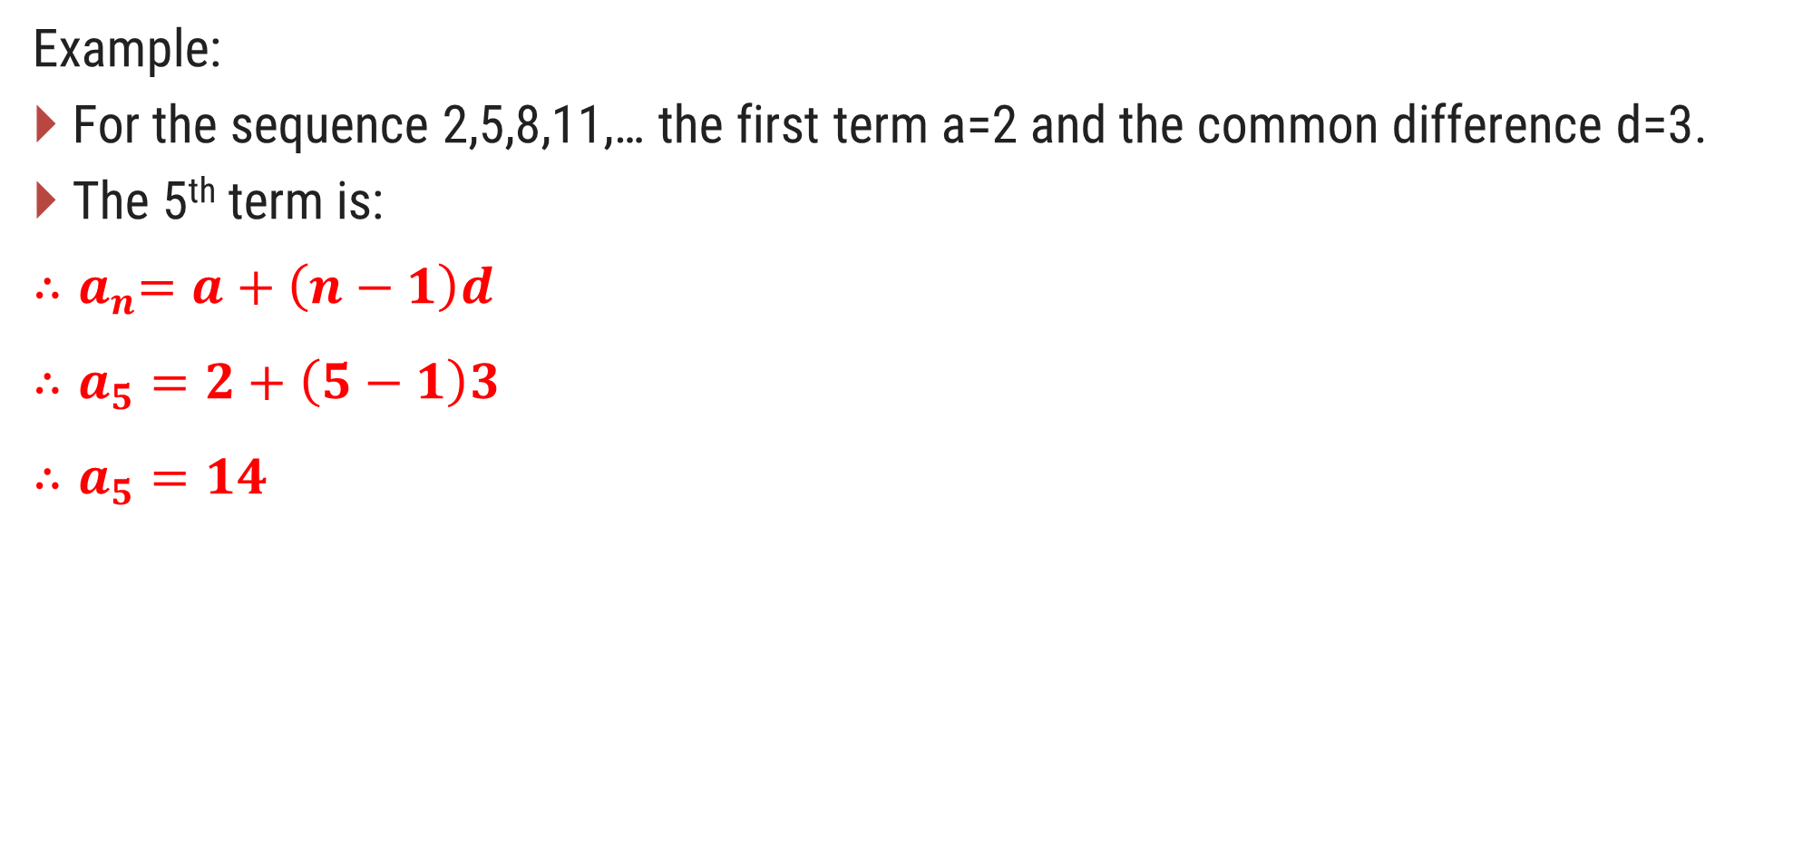
Progression
Example:
For the sequence 2,5,8,11,… the first term a=2 and the common difference d=3.
The 5th term is:
$${∴a}_{n}=a+\left(n−1\right)d$$
$$∴a_{5}=2+\left(5−1\right)3$$
$$∴a_{5}=14$$

Slide 25
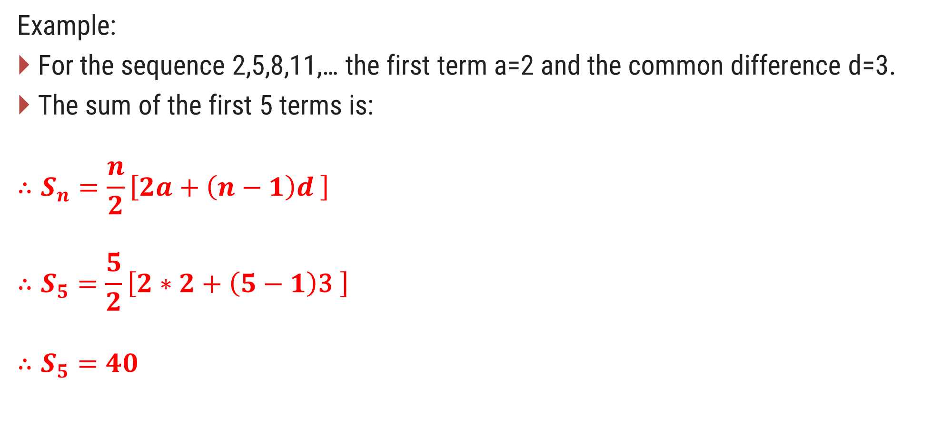
Progression
Example:
For the sequence 2,5,8,11,… the first term a=2 and the common difference d=3.
The sum of the first 5 terms is:
$$∴S_{n}=\frac{n}{2}\left[2a+\left(n−1\right)d \right]$$
$$∴S_{5}=\frac{5}{2}\left[2∗2+\left(5−1\right)\text{3} \right]$$
$$∴S_{5}=40$$

Slide 26
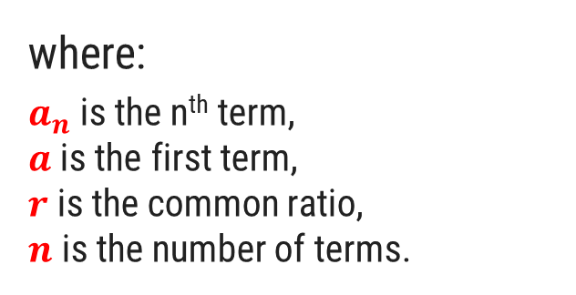
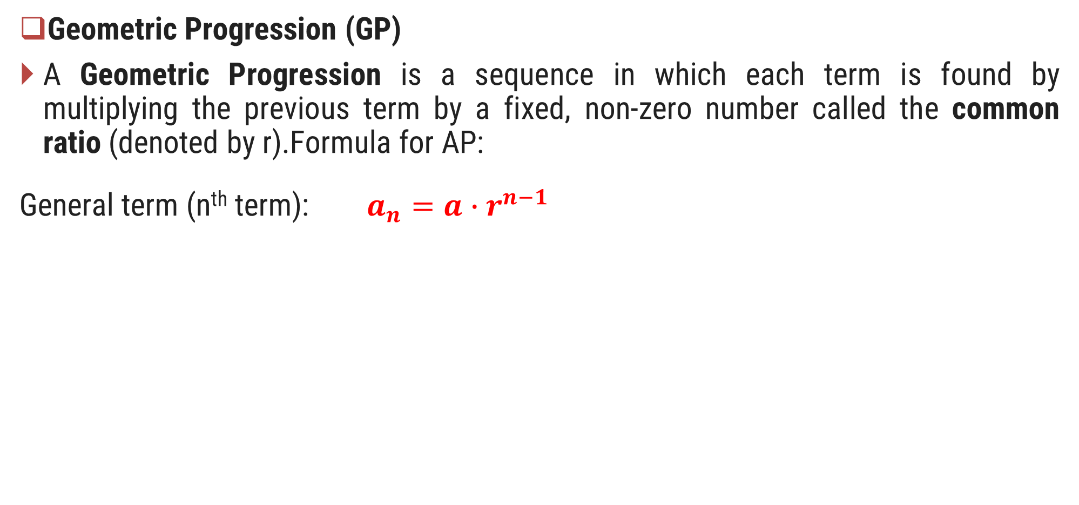
Progression
Geometric Progression (GP)
A Geometric Progression is a sequence in which each term is found by multiplying the previous term by a fixed, non-zero number called the common ratio (denoted by r).Formula for AP:
General term (n^{th} term): $a_{n}=a∙r^{n−1}$
where:
$a_{n}$​ is the n^{th} term,
$a$is the first term,
$r$ is the common ratio,
$n$ is the number of terms.

Slide 27

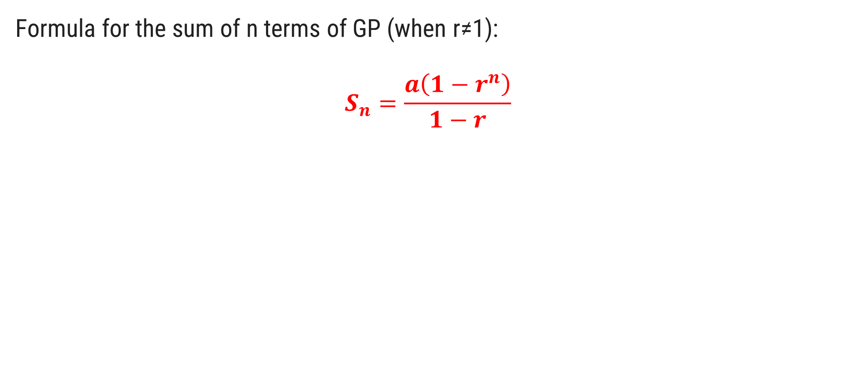
Progression
Formula for the sum of n terms of GP (when r≠1):
$$S_{n}=\frac{a\left(1−r^{n}\right)}{1−r}$$
where:
$a_{n}$​ is the n^{th} term,
$a$is the first term,
$r$ is the common ratio,
$n$ is the number of terms.

Slide 28
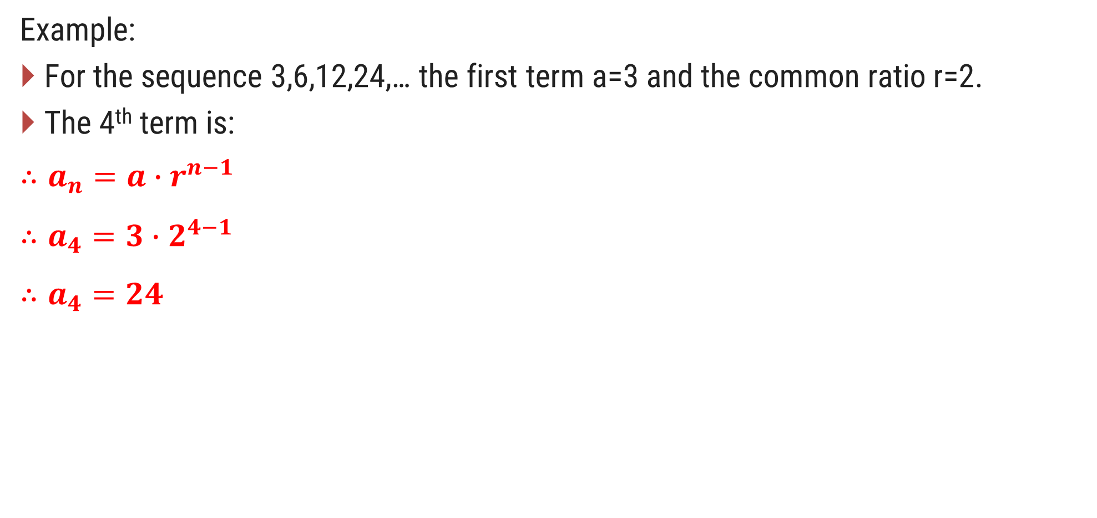
Progression
Example:
For the sequence 3,6,12,24,… the first term a=3 and the common ratio r=2.
The 4th term is:
$$∴a_{n}=a∙r^{n−1}$$
$$∴a_{4}=3∙2^{4−1}$$
$$∴a_{4}=24$$

Slide 29
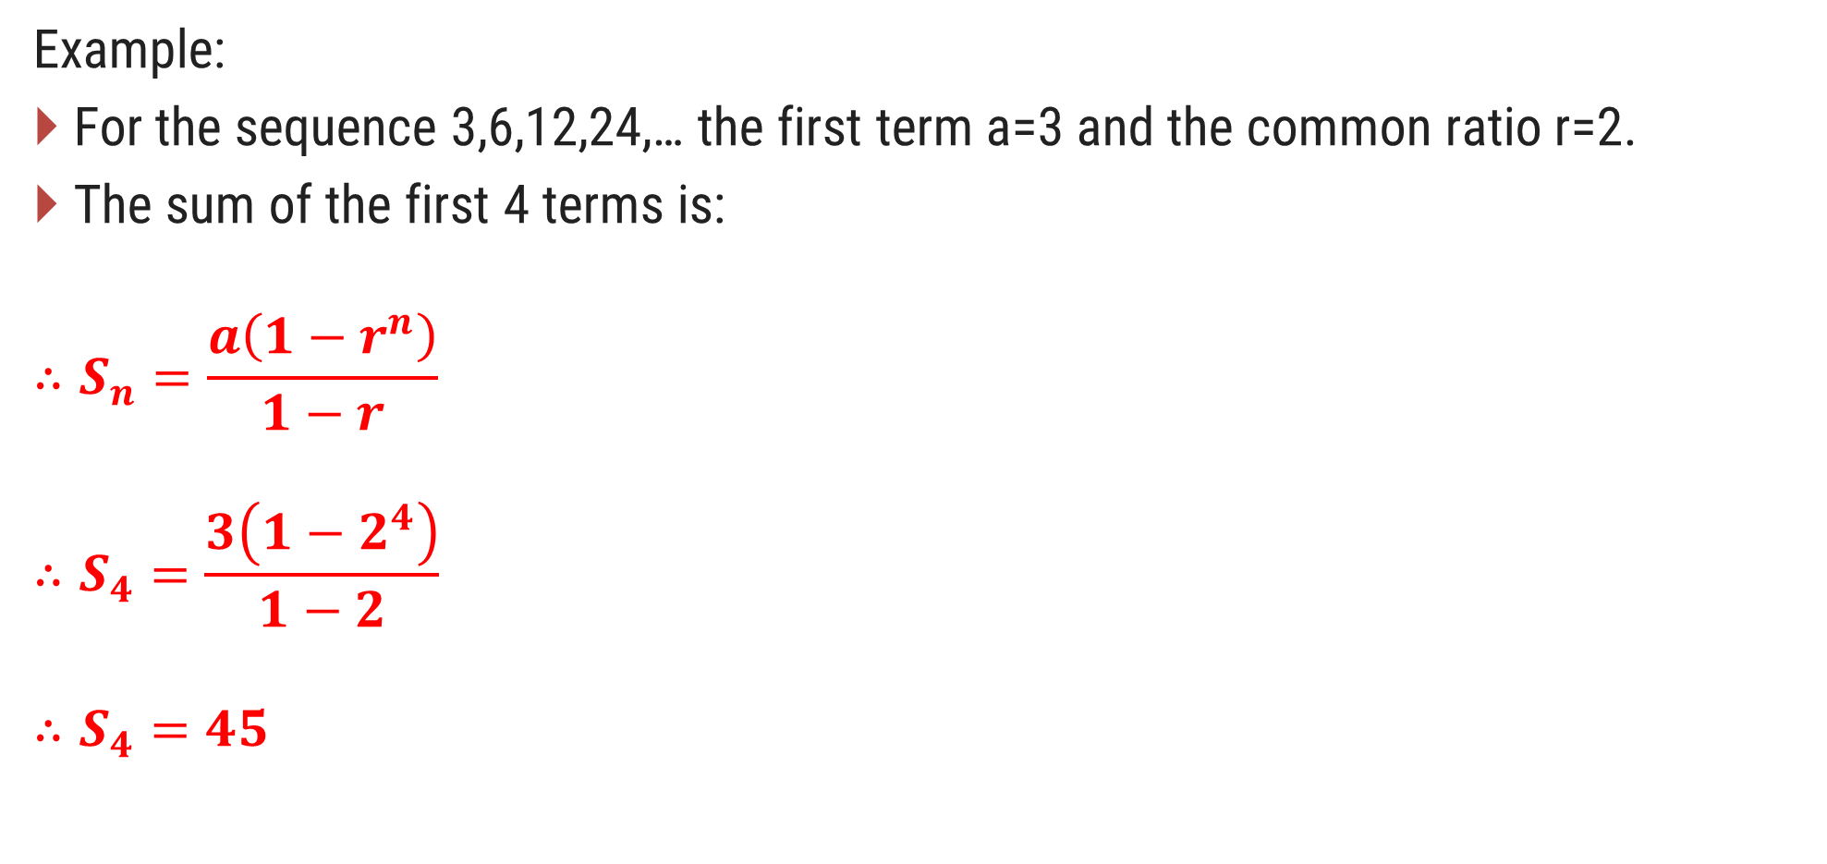
Progression
Example:
For the sequence 3,6,12,24,… the first term a=3 and the common ratio r=2.
The sum of the first 4 terms is:
$$∴S_{n}=\frac{a\left(1−r^{n}\right)}{1−r}$$
$$∴S_{4}=\frac{3\left(1−2^{4}\right)}{1−2}$$
$$∴S_{4}=45$$

Slide 30
Series
A Series is the sum of the terms of a sequence. Depending on the progression, the series can be arithmetic, geometric, etc.
The sum of the terms in an arithmetic progression is called an arithmetic series.
The sum of the terms in a geometric progression is called a geometric series.
Difference between Sequence and Series:
A sequence is simply a list of numbers following some pattern.
A series is the sum of terms of a sequence.

Slide 31
Overview & Important of Geometry
Geometry is a branch of mathematics concerned with the properties, dimensions, and relations of points, lines, surfaces, and solids.
It is divided into different types, with Euclidean Geometry being the most basic.
Geometry plays a crucial role in various fields like architecture, engineering, and daily life activities.

Slide 32
Overview & Important of Geometry
Key Concepts of Geometry
Points, Lines, and Planes
Point: A location with no size.
Line: One-dimensional, extending infinitely.
Plane: Two-dimensional, extending infinitely.

Slide 33
Overview & Important of Geometry
Angles
An angle is formed by two rays (sides) sharing a common endpoint (vertex).
The different types of angles are:
Acute angle: 0°<Angle<90°
Right angle: Angle=90°
Obtuse angle: 90°<Angle<180°
Straight angle: Angle=180°
Complementary angles: Two angles that add up to 90°
Supplementary angles: Two angles that add up to 180°

Slide 34
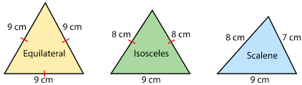
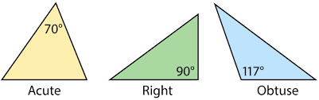
Overview & Important of Geometry
Triangles
Types: Equilateral, Isosceles, Scalene (by sides) & Acute, Right, Obtuse (by angles).

Slide 35
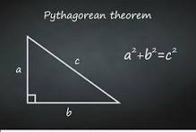
Overview & Important of Geometry
Pythagorean Theorem (Right triangle): a² + b² = c²

Slide 36
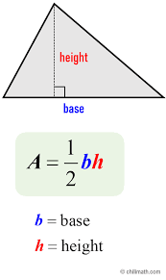
Overview & Important of Geometry
Area of Triangle: Area=(1/2)×Base×Height

Slide 37
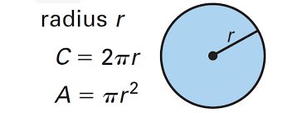
Overview & Important of Geometry
Circles
Circumference: C=2πr
Area: Area=πr²

Slide 38
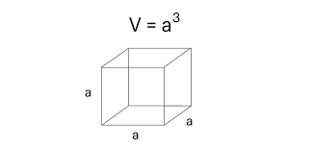
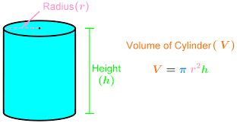
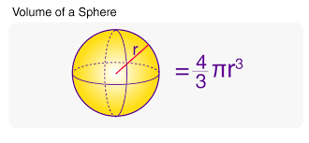
Overview & Important of Geometry
Solid Geometry
Cube Volume: V=Side³
Cylinder Volume: V=πr²h
Sphere Volume: V=(4/3) πr³

Slide 39
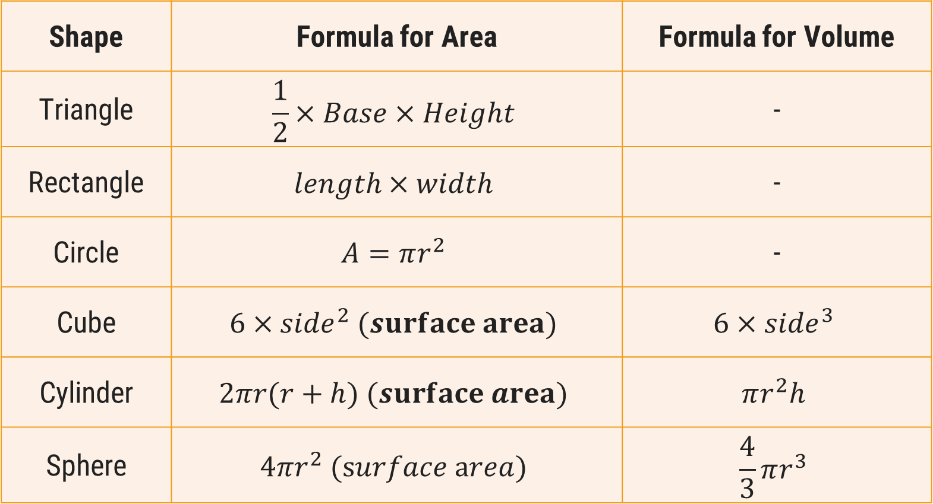
Overview & Important of Geometry
Shape | Formula for Area | Formula for Volume
Triangle | $$\frac{1}{2}×Base×Height$$ | -
Rectangle | $$length×width$$ | -
Circle | $$A=πr^{2}$$ | -
Cube | $$6×{side}^{2} (surface area)$$ | $$6×{side}^{3}$$
Cylinder | $$2πr(r+h) (surface area)$$ | $$πr^{2}h$$
Sphere | $$4πr^{2} (surface area)$$ | $$\frac{4}{3}πr^{3}$$

Slide 40
Overview & Important of Geometry
Importance of Geometry in Mathematics and Life
Problem Solving and Logical Reasoning: Geometry develops logical reasoning, critical thinking, and problem-solving skills. Proofs in geometry enhance deductive reasoning.
Practical Applications: Geometry is fundamental in fields like architecture, engineering, physics, and computer graphics. It’s essential for understanding shapes and spatial relationships.
Daily Life Uses: From navigation to designing objects and understanding how objects fit into spaces, geometry plays a vital role in everyday activities.
Advanced Mathematics: Geometry is also essential in advanced fields like calculus, topology, and algebraic geometry.

Slide 41
Overview & Important of Geometry
Examples of Geometry in Everyday Life
Designing Buildings: Architects use geometric principles to design structures, ensuring balance, stability, and aesthetics.
Navigation: GPS and mapping systems use geometric algorithms to calculate distances and paths between locations.
Computer Graphics: In animation and video games, geometry is used to model three-dimensional environments and simulate movement.

Slide 42
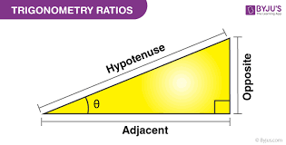
Trigonometry
Basics of Trigonometry
Trigonometry is the branch of mathematics that deals with the relationships between the sides and angles of triangles, particularly right-angled triangles.
It plays a crucial role in various fields such as physics, engineering, and architecture, as well as in the study of waves, oscillations, and many natural phenomena.

Slide 43
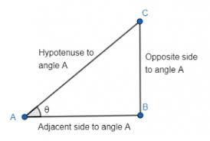
Basic Concepts in Trigonometry
Right-Angled Triangle
A right-angled triangle has one angle equal to 90°.
The side opposite the right angle is the hypotenuse, the longest side of the triangle.
The other two sides are called the adjacent (next to the angle) and opposite (facing the angle) sides.

Slide 44
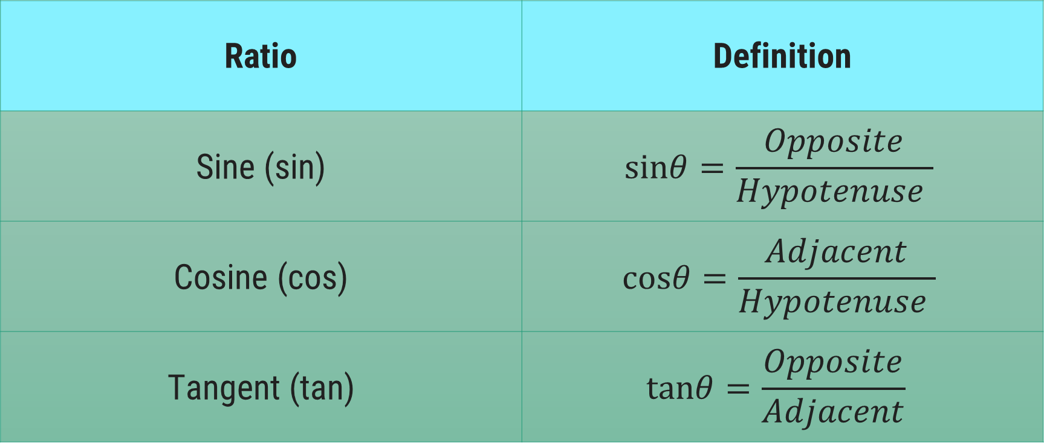
Basic Concepts in Trigonometry
Trigonometric Ratios (for right angles triangle only):
Ratio | Definition
Sine (sin⁡) | $$sinθ=\frac{Opposite}{Hypotenuse​ }$$
Cosine (cos⁡) | $$cosθ=\frac{Adjacent}{Hypotenuse​ }$$
Tangent (tan⁡) | $$tanθ=\frac{Opposite}{Adjacent}​$$

Slide 45
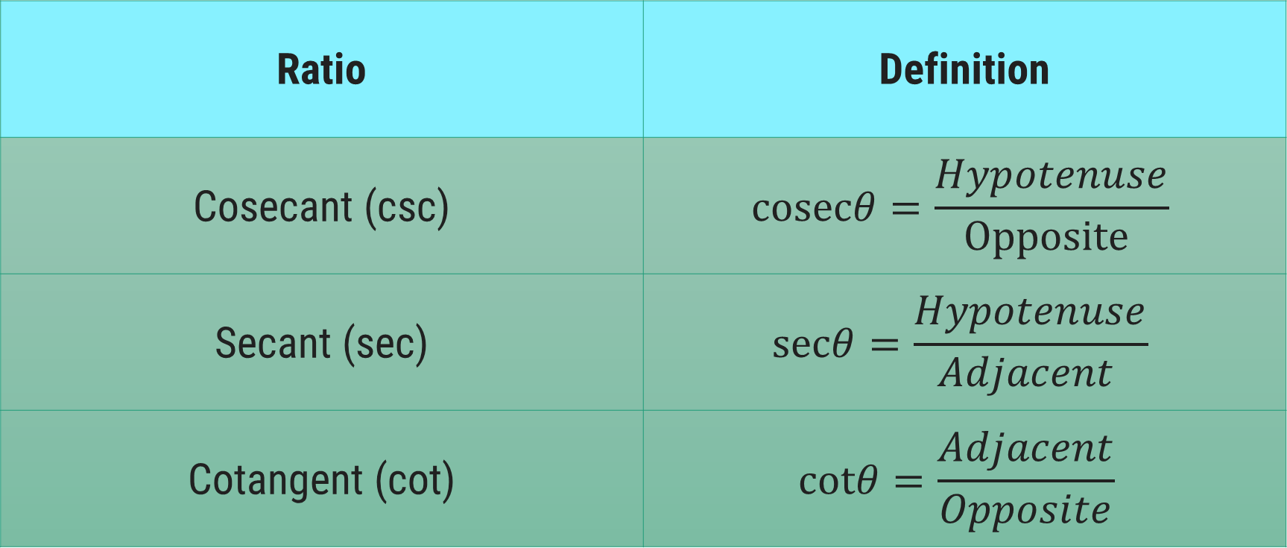
Basic Concepts in Trigonometry
Reciprocal(વ્યસ્ત​) of Trigonometric Ratios (for right angles triangle only):
Ratio | Definition
Cosecant (csc⁡) | $$cosecθ=\frac{Hypotenuse}{Opposite​ }$$
Secant (sec⁡) | $$secθ=\frac{Hypotenuse}{Adjacent​ }$$
Cotangent (cot⁡) | $$cotθ=\frac{Adjacent}{Opposite}​$$

Slide 46
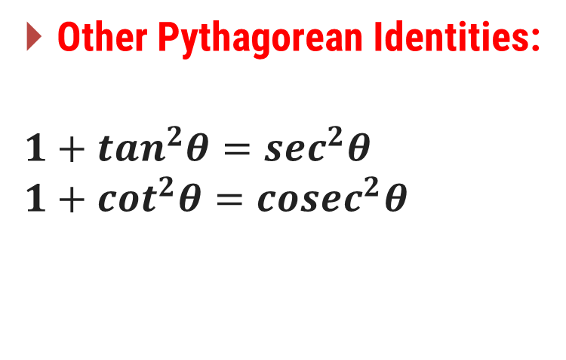
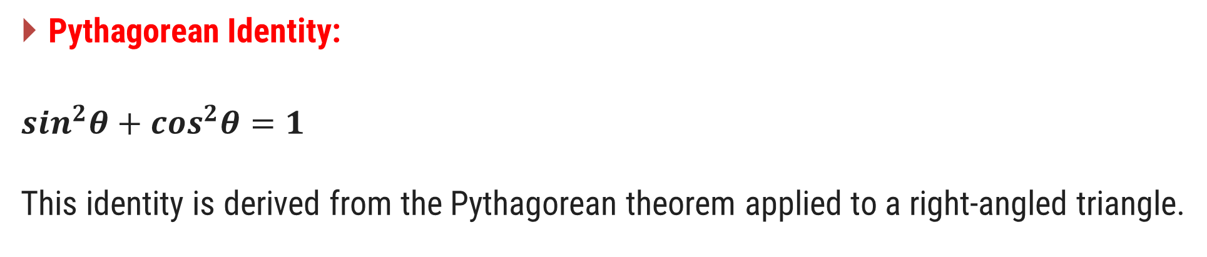
Trigonometric Identities
Pythagorean Identity:
$$\sin^{2}θ+\cos^{2}θ=1$$
This identity is derived from the Pythagorean theorem applied to a right-angled triangle.
Other Pythagorean Identities:
$$1+\tan^{2}θ=\sec^{2}θ$$
$$1+\cot^{2}θ={cosec}^{2}θ$$

Slide 47
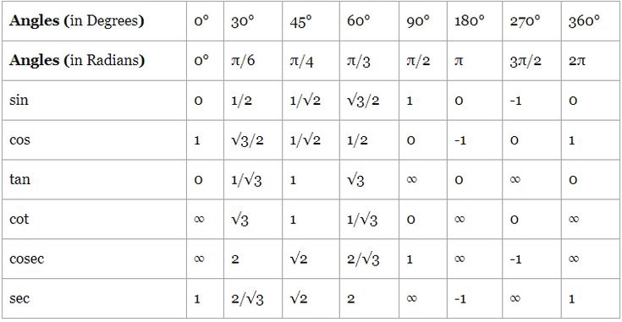
Trigonometric Values for Standard Angles

Slide 48
Applications of Trigonometry
Engineering and Architecture:
Used to calculate angles and distances in the construction of buildings, bridges, and other structures.
Navigation and Astronomy:
Used to find distances and angles between stars or planets.
Physics:
Used to study oscillations, waves, and mechanics.
Surveying:
Used to measure heights, distances, and angles on the ground.

Slide 49
Algebra
Algebra is a branch of mathematics that deals with symbols (usually letters) and the rules for manipulating these symbols to represent numbers and solve problems.
The symbols represent quantities without fixed values, known as variables.
Algebra helps in solving equations, understanding relationships between variables, and generalizing arithmetic operations.

Slide 50
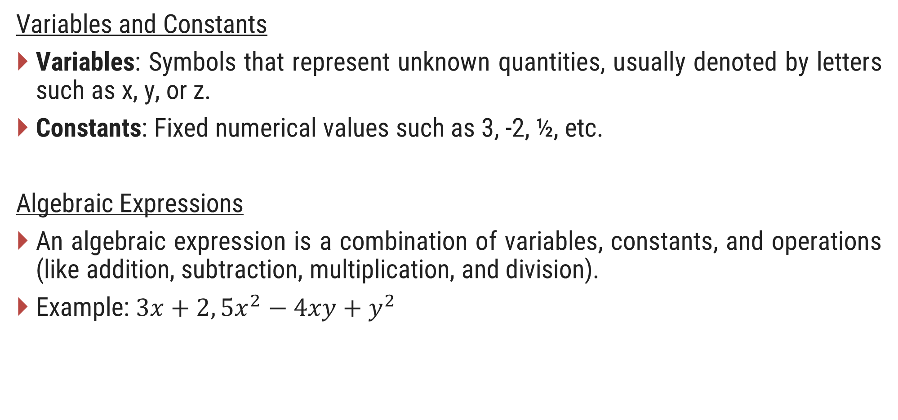
Basic Concepts in Algebra
Variables and Constants
Variables: Symbols that represent unknown quantities, usually denoted by letters such as x, y, or z.
Constants: Fixed numerical values such as 3, -2, ½, etc.
Algebraic Expressions
An algebraic expression is a combination of variables, constants, and operations (like addition, subtraction, multiplication, and division).
Example: $3x+2, {5x}^{2}−4xy+y^{2}$

Slide 51
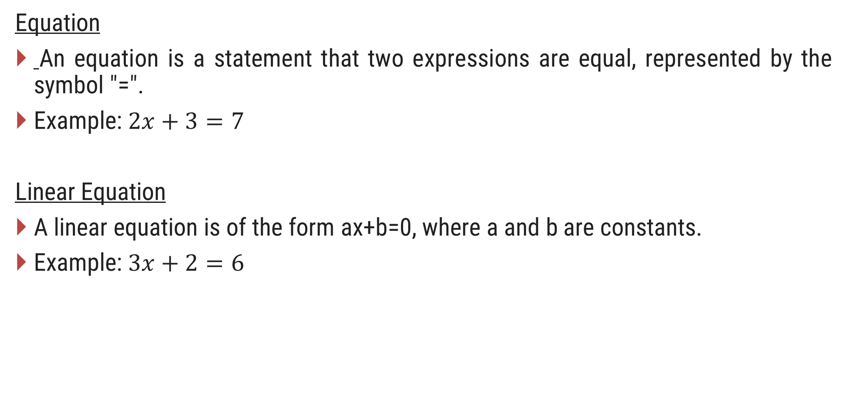
Basic Concepts in Algebra
Equation
An equation is a statement that two expressions are equal, represented by the symbol "=".
Example: $2x+3=7$
Linear Equation
A linear equation is of the form ax+b=0, where a and b are constants.
Example: $3x+2=6$

Slide 52
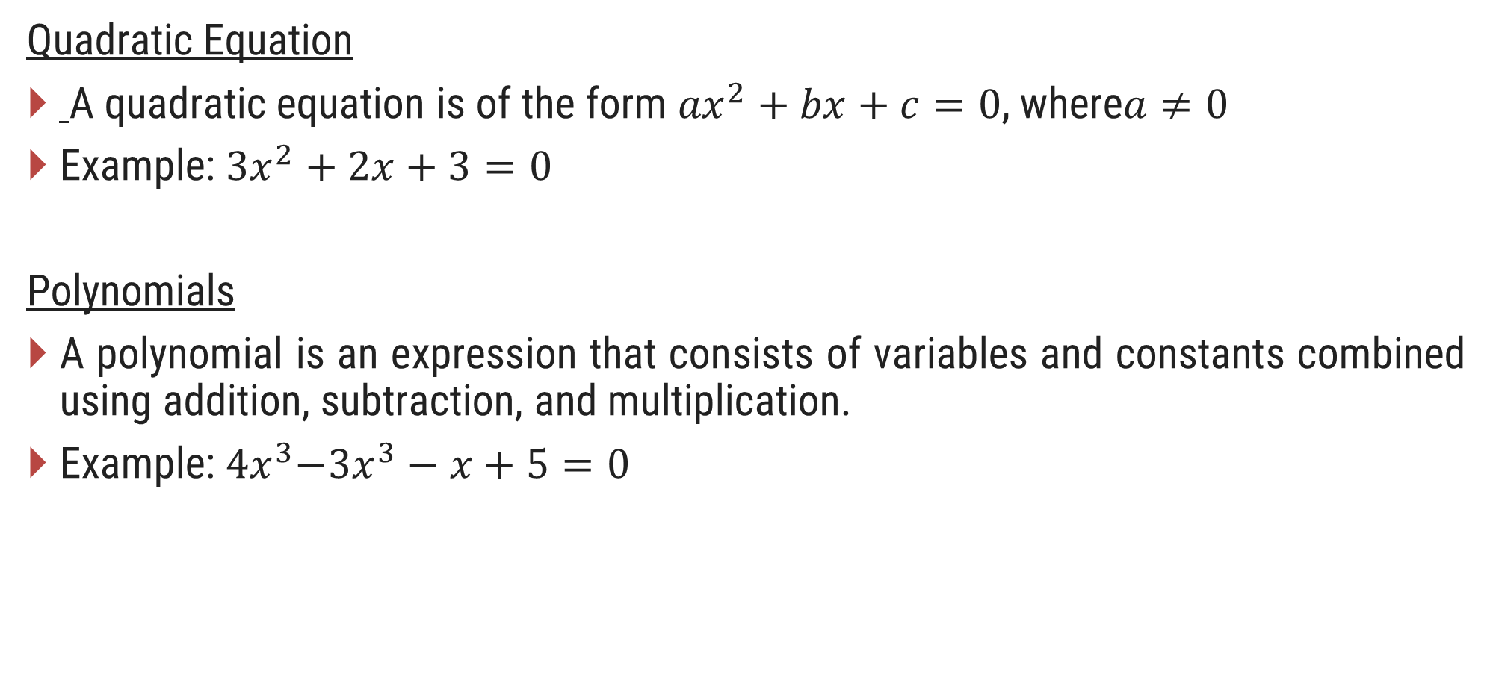
Basic Concepts in Algebra
Quadratic Equation
A quadratic equation is of the form ${ax}^{2}+bx+c=0$, where$a≠0$
Example: ${3x}^{2}+2x+3=0$
Polynomials
A polynomial is an expression that consists of variables and constants combined using addition, subtraction, and multiplication.
Example:${ 4x}^{3}−{3x}^{3}−x+5=0$

Slide 53
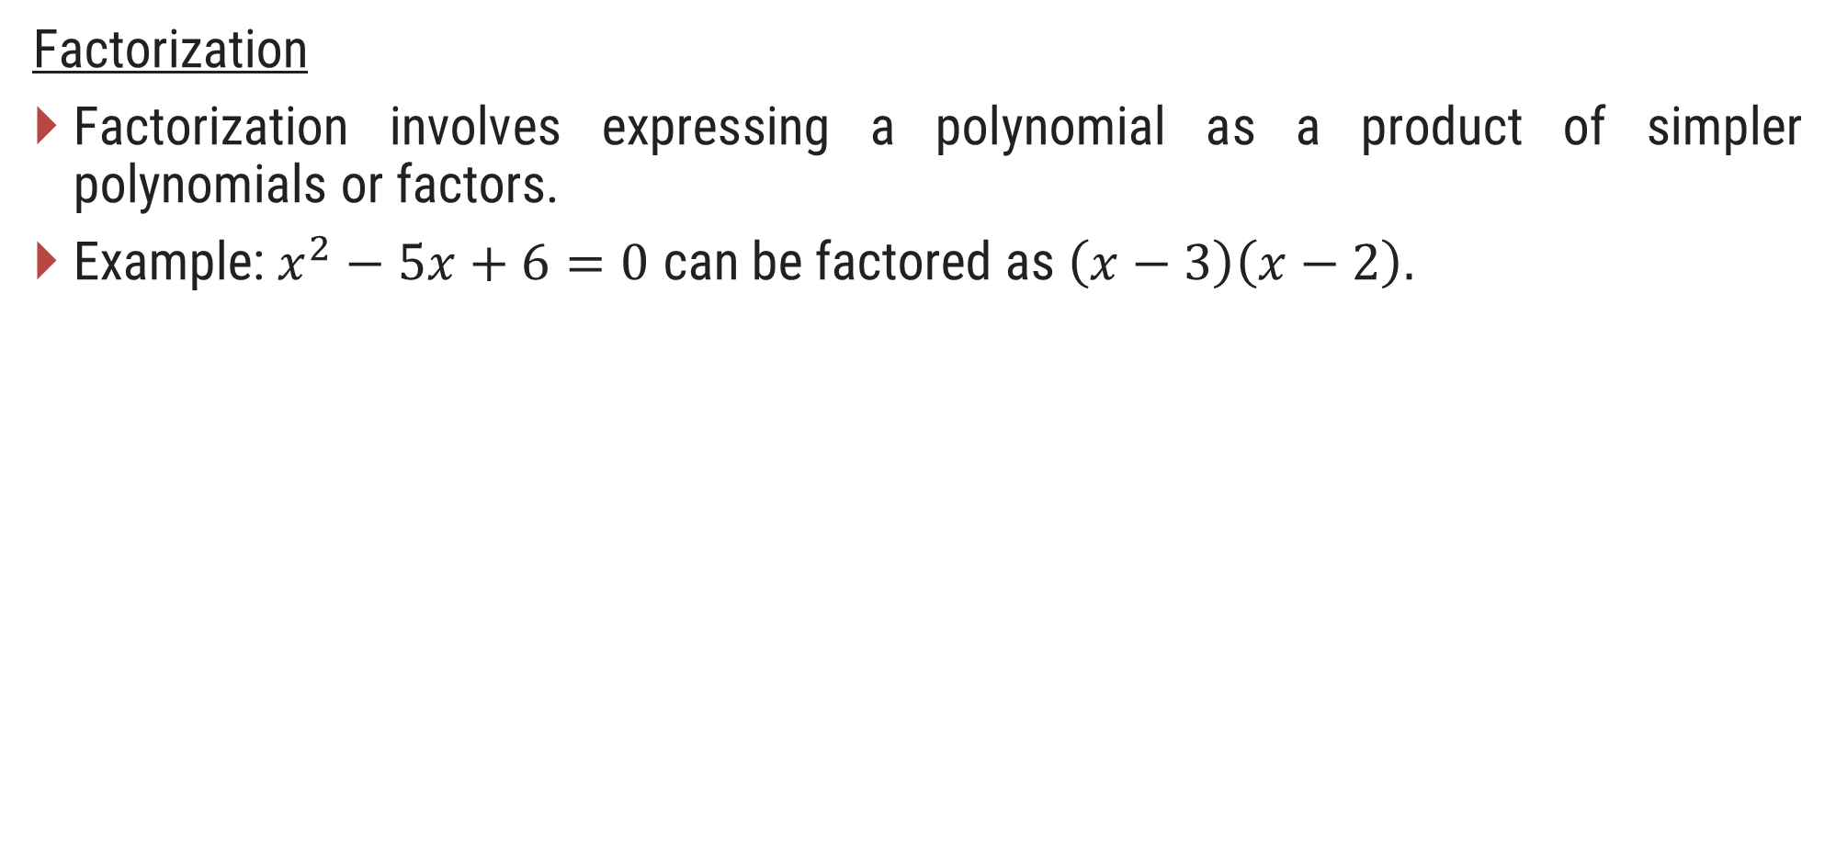
Basic Concepts in Algebra
Factorization
Factorization involves expressing a polynomial as a product of simpler polynomials or factors.
Example: $x^{2}−5x+6=0$ can be factored as $\left(x−3\right)\left(x−2\right).$

Slide 54
Applications of Algebra
Physics: Describing laws of motion, forces, and energy using algebraic equations.
Economics: Modelling and predicting economic trends, profit and loss calculations.
Engineering: Designing systems, circuits, and structures based on algebraic principles.
Computer Science: Algorithm design, coding, and cryptography rely on algebraic logic.

Slide 55
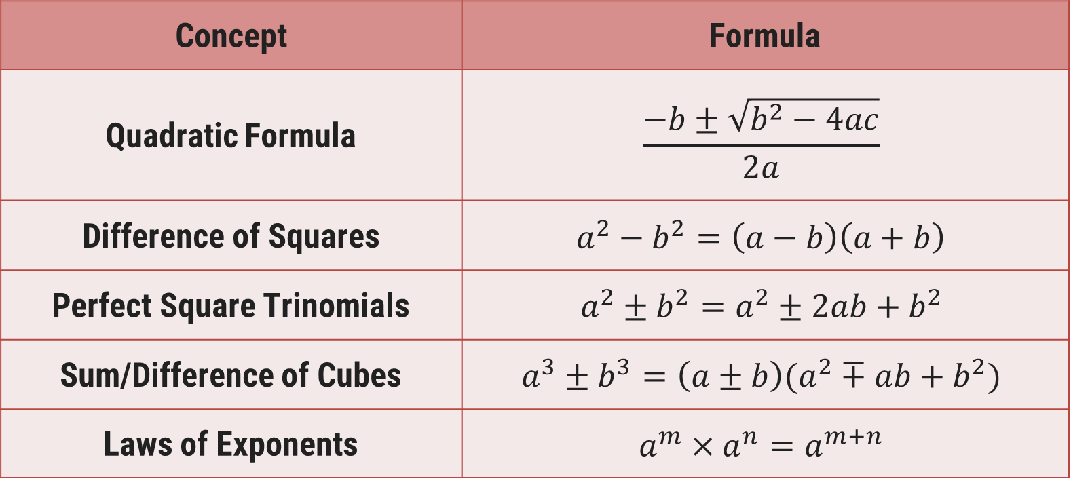
Summary Table of Important Algebraic Formulas
Concept | Formula
Quadratic Formula | $$\frac{−b±\sqrt{b^{2}−4ac}}{2a}$$
Difference of Squares | $$a^{2}−b^{2}=\left(a−b\right)\left(a+b\right)$$
Perfect Square Trinomials | $$a^{2}±b^{2}=a^{2}±2ab+b^{2}$$
Sum/Difference of Cubes | $$a^{3}±b^{3}=\left(a±b\right)(a^{2}∓ab+b^{2})$$
Laws of Exponents | $$a^{m}×a^{n}=a^{m+n}$$

Slide 56
Thank You
Indian Knowledge System
#2301DU005

